Slide 1
Game-Playing & Adversarial Search

Slide 2
Types of Games in AI
Perfect Information Games
  All players have complete knowledge of the game state.
  Example: Chess, Checkers, Tic-Tac-Toe.
Imperfect Information Games
  Some aspects of the game are hidden from players.
  Example: Poker, Kriegspiel.
Deterministic Games
  No chance elements; outcome depends entirely on players’ actions.
  Example: Chess.
Chance (Nondeterministic) Games
  Outcomes depend partly on random events.
  Example: Backgammon, Monopoly.
Stochastic Games
  Generalization of chance games; both randomness and player decisions affect the outcome.
  Example: Dice-based strategy games.
Zero-Sum Games
  One player’s gain equals the other player’s loss.
  Example: Chess, Tic-Tac-Toe.
Non-Zero-Sum Games
  Players may cooperate or both benefit; outcomes are not strictly opposed.
  Example: Prisoner’s Dilemma, Trade negotiations.

Slide 3
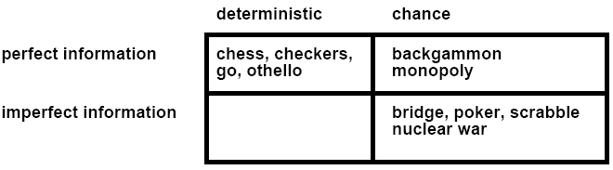
Types of Games
battleship
Kriegspiel
Not Considered: Physical games like tennis, croquet, ice hockey, etc.
(but see “robot soccer” http://www.robocup.org/)

Slide 4
Typical assumptions
Two agents whose actions alternate
Utility values for each agent are the opposite of the other
  This creates the adversarial situation
Fully observable environments
In game theory terms:
  “Deterministic, turn-taking, zero-sum games of perfect information”
Generalizes to stochastic games, multiple players, non zero-sum, etc.
Compare to, e.g., “Prisoner’s Dilemma” (p. 666-668, R&N 3rd ed.)
  “Deterministic, NON-turn-taking, NON-zero-sum game of IMperfect information”

Slide 5

Game tree (2-player, deterministic, turns)
How do we search this tree to find the optimal move?

Slide 6
Search versus Games
Search – no adversary
  Solution is (heuristic) method for finding goal
  Heuristics and CSP techniques can find optimal solution
  Evaluation function: estimate of cost from start to goal through given node
  Examples: path planning, scheduling activities
Games – adversary
  Solution is strategy
    strategy specifies move for every possible opponent reply.
  Time limits force an approximate solution
  Evaluation function: evaluate “goodness” of game position
  Examples: chess, checkers, Othello, backgammon

Slide 7
Games as Search
Two players: MAX and MIN
MAX moves first and they take turns until the game is over
  Winner gets reward, loser gets penalty.
  “Zero sum” means the sum of the reward and the penalty is a constant.
Formal definition as a search problem:
  Initial state: Set-up specified by the rules, e.g., initial board configuration of chess.
  Player(s): Defines which player has the move in a state.
  Actions(s): Returns the set of legal moves in a state.
  Result(s,a): Transition model defines the result of a move.
  (2nd ed.: Successor function: list of (move,state) pairs specifying legal moves.)
  Terminal-Test(s): Is the game finished? True if finished, false otherwise.
  Utility function(s,p): Gives numerical value of terminal state s for player p.
    E.g., win (+1), lose (-1), and draw (0) in tic-tac-toe.
    E.g., win (+1), lose (0), and draw (1/2) in chess.
MAX uses search tree to determine next move.

Slide 8
An optimal procedure: The Min-Max method
Designed to find the optimal strategy for Max and find best move:
1. Generate the whole game tree, down to the leaves.
2. Apply utility (payoff) function to each leaf.
3. Back-up values from leaves through branch nodes:
  a Max node computes the Max of its child values
  a Min node computes the Min of its child values
4. At root: choose the move leading to the child of highest value.

Slide 9
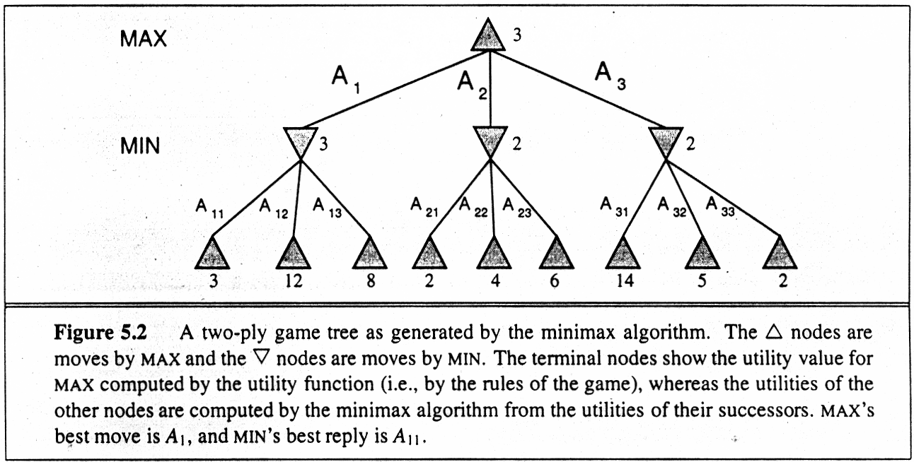
Game Trees

Slide 10
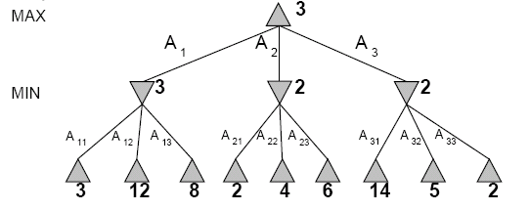
Two-Ply Game Tree

Slide 11
Two-Ply Game Tree

Slide 12
Two-Ply Game Tree
Minimax maximizes the utility for the worst-case outcome for max
The minimax decision

Slide 13
Pseudocode for Minimax Algorithm
function MINIMAX-DECISION(state) returns an action
inputs: state, current state in game
return arg max_{a∈ACTIONS(state)} MIN-VALUE(Result(state,a))
function MAX-VALUE(state) returns a utility value
if TERMINAL-TEST(state) then return UTILITY(state)
v ← −∞
for a in ACTIONS(state) do
v ← MAX(v,MIN-VALUE(Result(state,a)))
return v
function MIN-VALUE(state) returns a utility value
if TERMINAL-TEST(state) then return UTILITY(state)
v ← +∞
for a in ACTIONS(state) do
v ← MIN(v,MAX-VALUE(Result(state,a)))
return v

Slide 14
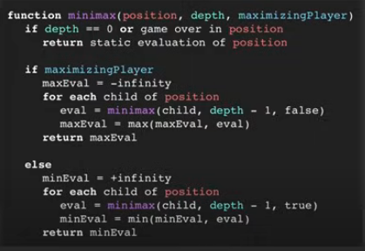
Pseudocode for Minimax Algorithm

Slide 15
Properties of minimax
Complete?
  Yes (if tree is finite).
Optimal?
  Yes (against an optimal opponent).
    No. (Why not?)
Time complexity?
  O(b^{m})
Space complexity?
  O(bm) (depth-first search, generate all actions at once)
  O(m) (backtracking search, generate actions one at a time)
  Can it be beaten by an opponent playing sub-optimally?

Slide 16
Game Tree Size
Tic-Tac-Toe
  b ≈ 5 legal actions per state on average, total of 9 plies in game.
    “ply” = one action by one player, “move” = two plies.
  5⁹ = 1,953,125
  9! = 362,880 (Computer goes first)
  8! = 40,320 (Computer goes second)
  → exact solution quite reasonable
Chess
  b ≈ 35 (approximate average branching factor)
  d ≈ 100 (depth of game tree for “typical” game)
  b^{d} ≈ 35¹⁰⁰ ≈ 10¹⁵⁴ nodes!!
  → exact solution completely infeasible
It is usually impossible to develop the whole search tree.

Slide 17
(Static) Heuristic Evaluation Functions
An Evaluation Function:
  Estimates how good the current board configuration is for a player.
  Typically, evaluate how good it is for the player, how good it is for the opponent, then subtract the opponent’s score from the player’s.
  Often called “static” because it is called on a static board position.
  Othello: Number of white pieces - Number of black pieces
  Chess: Value of all white pieces - Value of all black pieces
Typical values from -infinity (loss) to +infinity (win) or [-1, +1].
If the board evaluation is X for a player, it’s -X for the opponent
  “Zero-sum game”

Slide 18
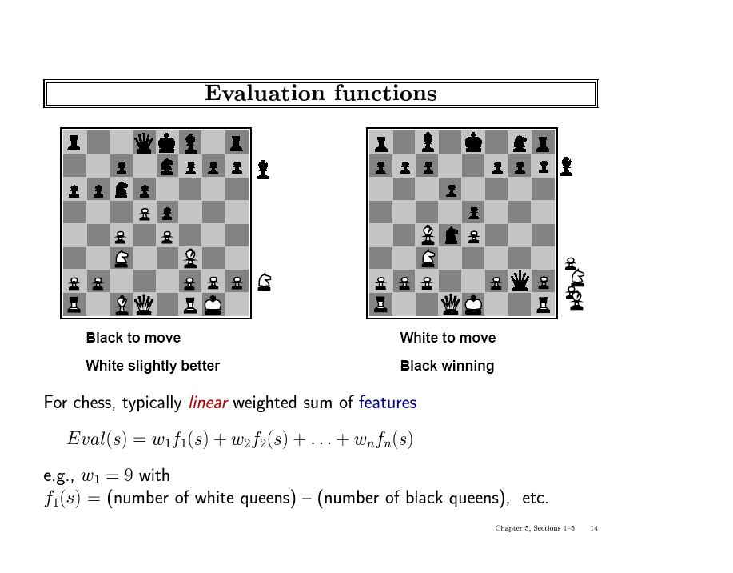

Slide 19
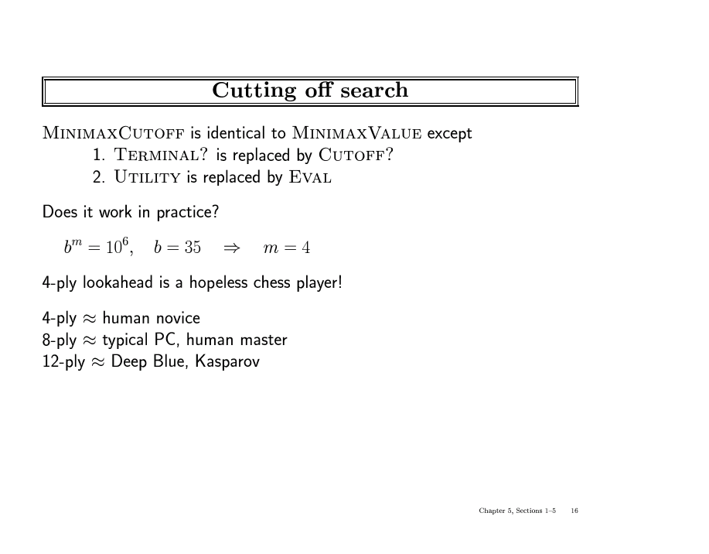

Slide 20
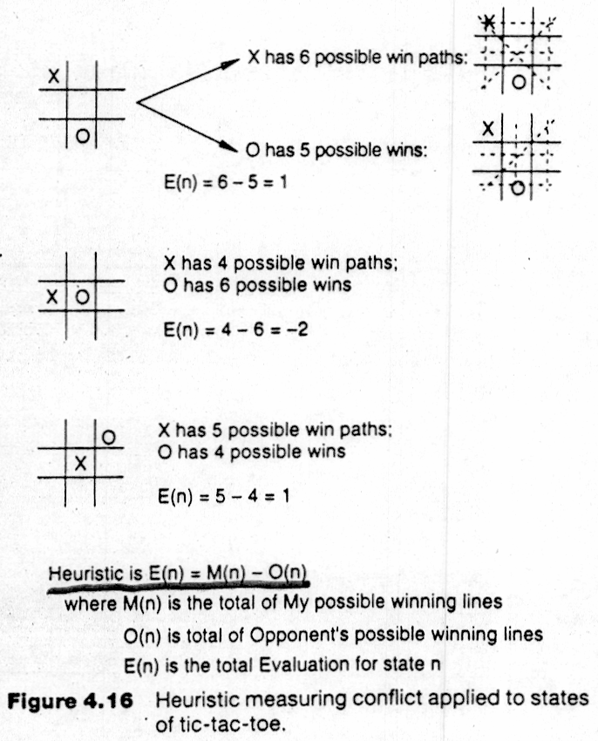
Applying MiniMax to tic-tac-toe
The static heuristic evaluation function

Slide 21
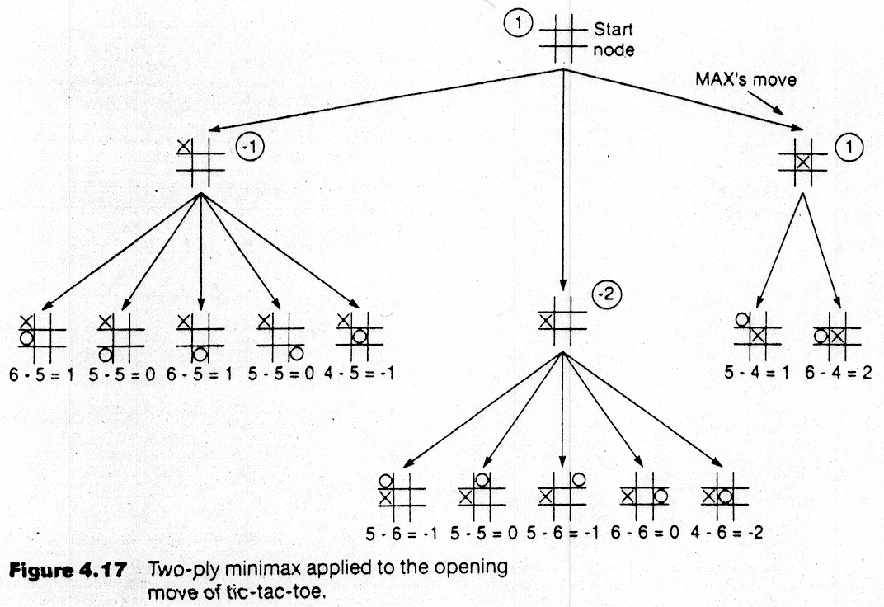
Backup Values

Slide 22
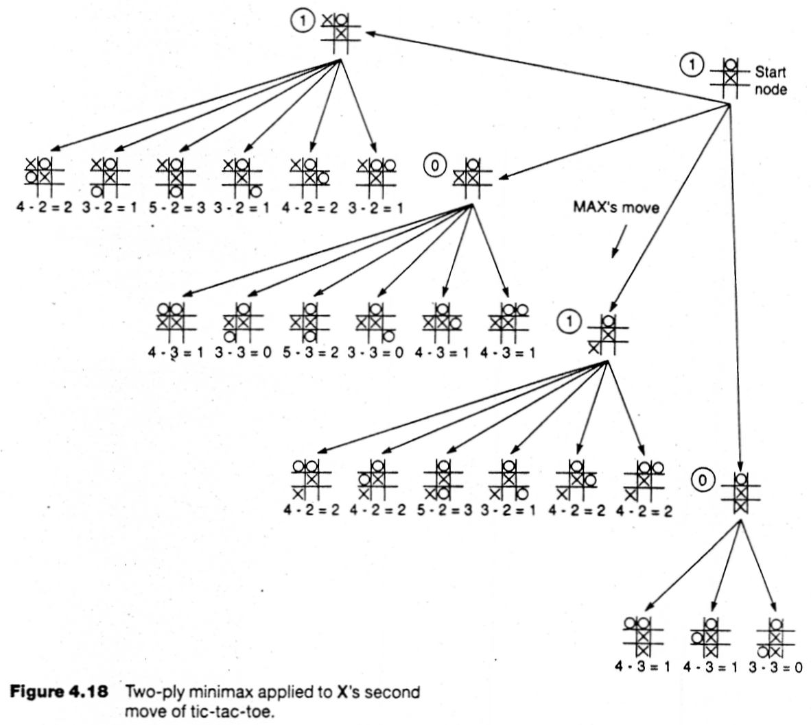

Slide 23
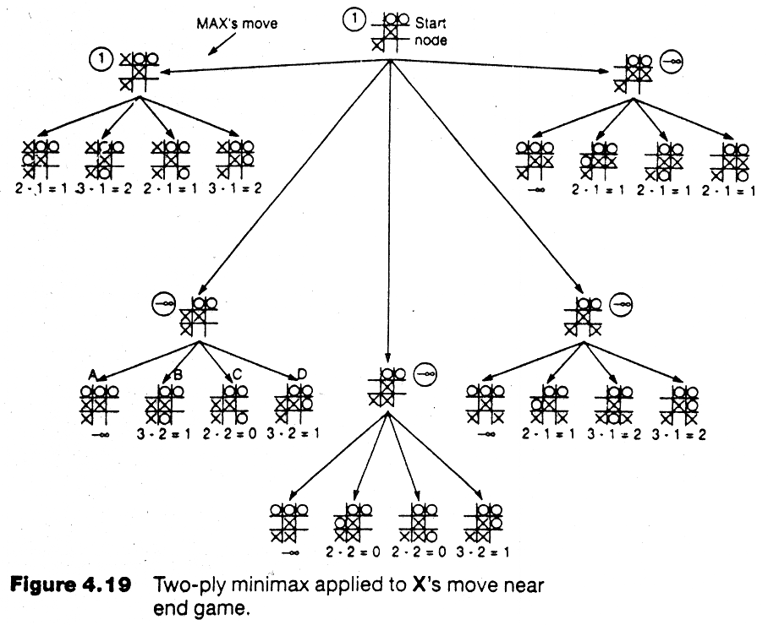

Slide 24
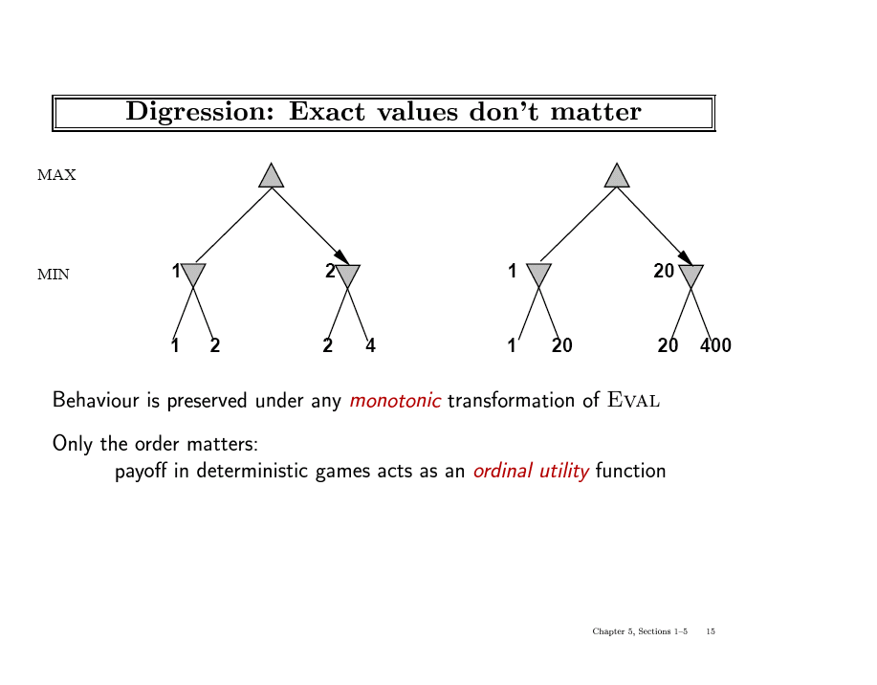

Slide 25
Alpha-Beta Pruning
Exploiting the Fact of an Adversary
If a position is provably bad:
  It is NO USE expending search time to find out exactly how bad
If the adversary can force a bad position:
  It is NO USE expending search time to find out the good positions that the adversary won’t let you achieve anyway
Bad = not better than we already know we can achieve elsewhere.
Contrast normal search:
  ANY node might be a winner.
  ALL nodes must be considered.
  (A* avoids this through knowledge, i.e., heuristics)

Slide 26
Tic-Tac-Toe Example with Alpha-Beta Pruning
Backup Values

Slide 27
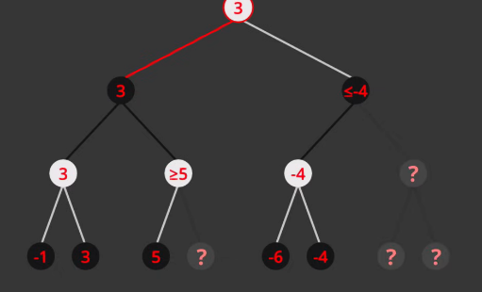
Example 1 Alpha Beta Pruning

Slide 28
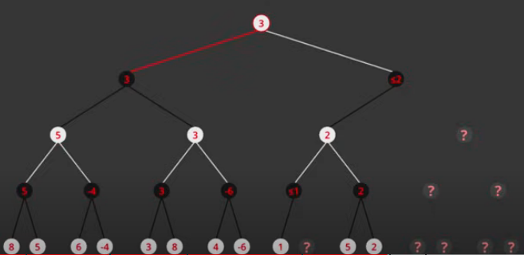
Example 2 for Alpha Beta Pruning

Slide 29
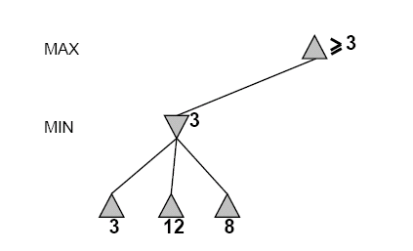
Another Alpha-Beta Example
Do DF-search until first leaf
Range of possible values
(−∞,+∞)
(−∞, +∞)

Slide 30
Alpha-Beta Example (continued)
(−∞,+∞)
(−∞,3]

Slide 31
Alpha-Beta Example (continued)
(−∞,+∞)
(−∞,3]

Slide 32
Alpha-Beta Example (continued)
[3,+∞)
[3,3]

Slide 33
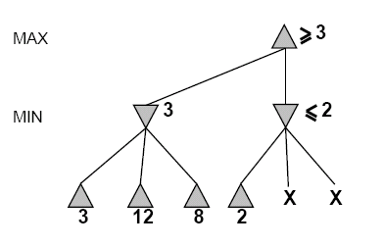
Alpha-Beta Example (continued)
[3,+∞)
This node is
worse for MAX
[3,3]
(−∞,2]

Slide 34
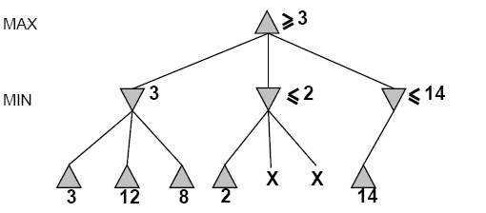
Alpha-Beta Example (continued)
[3,14]
,
[3,3]
(−∞,2]
(−∞,14]

Slide 35
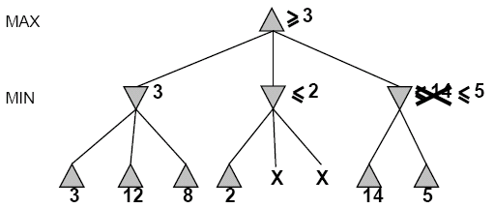

Alpha-Beta Example (continued)
[3,5]
,
[3,3]
(−∞,2]
(−∞,5]

Slide 36
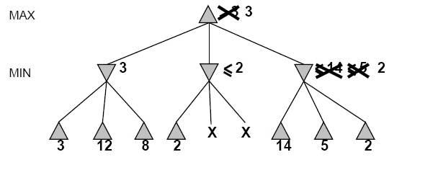
Alpha-Beta Example (continued)
[3,3]
[3,3]
(−∞,2]
[2,2]

Slide 37
Alpha-Beta Example (continued)
[3,3]
[3,3]
(−∞,2]
[2,2]

Slide 38
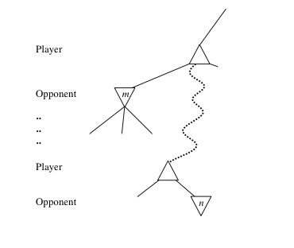
General alpha-beta pruning
Consider a node n in the tree ---
If player has a better choice at:
  Parent node of n
  Or any choice point further up
Then n will never be reached in play.
Hence, when that much is known about n, it can be pruned.

Slide 39
Alpha-beta Algorithm
Depth first search
  only considers nodes along a single path from root at any time
α = highest-value choice found at any choice point of path for MAX
(initially, α = −infinity)
β = lowest-value choice found at any choice point of path for MIN
(initially, β = +infinity)
Pass current values of α and β down to child nodes during search.
Update values of α and β during search:
  MAX updates α at MAX nodes
  MIN updates β at MIN nodes
Prune remaining branches at a node when α ≥ β

Slide 40
When to Prune
Prune whenever α ≥ β.
  Prune below a Max node whose alpha value becomes greater than or equal to the beta value of its ancestors.
    Max nodes update alpha based on children’s returned values.
  Prune below a Min node whose beta value becomes less than or equal to the alpha value of its ancestors.
    Min nodes update beta based on children’s returned values.

Slide 41
Pseudocode for Alpha-Beta Algorithm
function ALPHA-BETA-SEARCH(state) returns an action
inputs: state, current state in game
v←MAX-VALUE(state, - ∞ , +∞)
return the action in SUCCESSORS(state) with value v

Slide 42
Pseudocode for Alpha-Beta Algorithm
function ALPHA-BETA-SEARCH(state) returns an action
inputs: state, current state in game
v←MAX-VALUE(state, - ∞ , +∞)
return the action in ACTIONS(state) with value v
function MAX-VALUE(state,α , β) returns a utility value
if TERMINAL-TEST(state) then return UTILITY(state)
v ← - ∞
for a in ACTIONS(state) do
v ← MAX(v,MIN-VALUE(Result(s,a), α , β))
if v ≥ β then return v
α ← MAX(α ,v)
return v
(MIN-VALUE is defined analogously)

Slide 43
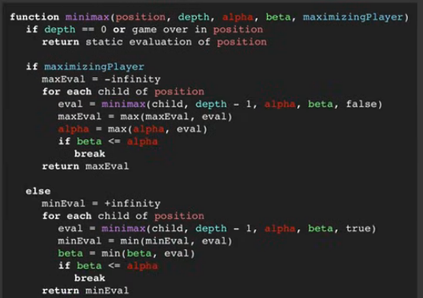
Alpha Beta Pruning Pseudo code

Slide 44
Alpha-Beta Example Revisited
Do DF-search until first leaf
α, β, initial values
α=−∞
β =+∞
α, β, passed to kids
α=−∞
β =+∞

Slide 45
Alpha-Beta Example (continued)
α=−∞
β =+∞
α=−∞
β =3
MIN updates β, based on kids

Slide 46
Alpha-Beta Example (continued)
α=−∞
β =+∞
α=−∞
β =3
MIN updates β, based on kids.
No change.

Slide 47
Alpha-Beta Example (continued)
MAX updates α, based on kids.
α=3
β =+∞
3 is returned
as node value.

Slide 48
Alpha-Beta Example (continued)
α=3
β =+∞
α, β, passed to kids
α=3
β =+∞

Slide 49
Alpha-Beta Example (continued)
α=3
β =+∞
MIN updates β,
based on kids.
α=3
β =2

Slide 50
Alpha-Beta Example (continued)
α=3
β =+∞
α=3
β =2
α ≥ β,
so prune.

Slide 51
Alpha-Beta Example (continued)
MAX updates α, based on kids.
No change.
α=3
β =+∞
2 is returned
as node value.

Slide 52
Alpha-Beta Example (continued)
α=3
β =+∞
,
α, β, passed to kids
α=3
β =+∞

Slide 53
Alpha-Beta Example (continued)
α=3
β =+∞
,
MIN updates β,
based on kids.
α=3
β =14

Slide 54
Alpha-Beta Example (continued)
α=3
β =+∞
,
MIN updates β,
based on kids.
α=3
β =5

Slide 55
Alpha-Beta Example (continued)
α=3
β =+∞
2 is returned
as node value.
2

Slide 56
Alpha-Beta Example (continued)
Max calculates the same node value, and makes the same move!
2

Slide 57
Effectiveness of Alpha-Beta Search
Worst-Case
  branches are ordered so that no pruning takes place. In this case alpha-beta gives no improvement over exhaustive search
Best-Case
  each player’s best move is the left-most child (i.e., evaluated first)
  in practice, performance is closer to best rather than worst-case
  E.g., sort moves by the remembered move values found last time.
  E.g., expand captures first, then threats, then forward moves, etc.
  E.g., run Iterative Deepening search, sort by value last iteration.
In practice often get O(b^{(d/2)}) rather than O(b^{d})
  this is the same as having a branching factor of sqrt(b),
    (sqrt(b))^{d} = b^{(d/2)},i.e., we effectively go from b to square root of b
  e.g., in chess go from b ~ 35 to b ~ 6
    this permits much deeper search in the same amount of time

Slide 58
Final Comments about Alpha-Beta Pruning
Pruning does not affect final results
Entire subtrees can be pruned.
Good move ordering improves effectiveness of pruning
Repeated states are again possible.
  Store them in memory = transposition table

Slide 59
Iterative (Progressive) Deepening
In real games, there is usually a time limit T on making a move
How do we take this into account?
using alpha-beta we cannot use “partial” results with any confidence unless the full breadth of the tree has been searched
  So, we could be conservative and set a conservative depth-limit which guarantees that we will find a move in time < T
    disadvantage is that we may finish early, could do more search
In practice, iterative deepening search (IDS) is used
  IDS runs depth-first search with an increasing depth-limit
  when the clock runs out we use the solution found at the previous depth limit

Slide 60
Heuristics and Game Tree Search: limited horizon
The Horizon Effect
  sometimes there’s a major “effect” (such as a piece being captured) which is just “below” the depth to which the tree has been expanded.
  the computer cannot see that this major event could happen because it has a “limited horizon”.
  there are heuristics to try to follow certain branches more deeply to detect such important events
  this helps to avoid catastrophic losses due to “short-sightedness”
Heuristics for Tree Exploration
  it may be better to explore some branches more deeply in the allotted time
  various heuristics exist to identify “promising” branches

Slide 61
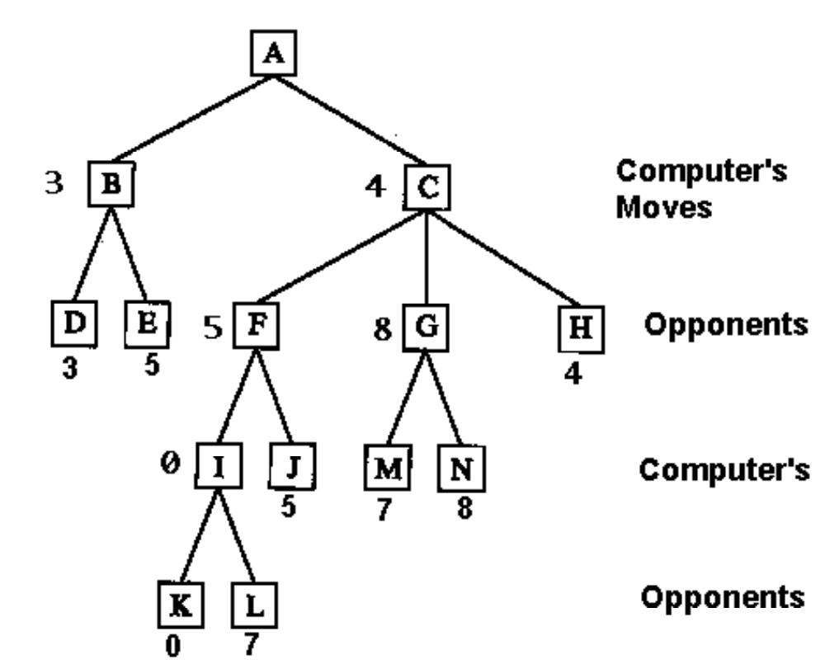
Deeper Game Trees

Slide 62
Eliminate Redundant Nodes
On average, each board position appears in the search tree approximately ~10¹⁵⁰ / ~10⁴⁰ ≈ 10¹⁰⁰ times.
  => Vastly redundant search effort.
Can’t remember all nodes (too many).
  => Can’t eliminate all redundant nodes.
However, some short move sequences provably lead to a redundant position.
  These can be deleted dynamically with no memory cost
Example:
  P-QR4 P-QR4; 2. P-KR4 P-KR4
  leads to the same position as
  1. P-QR4 P-KR4; 2. P-KR4 P-QR4

Slide 63
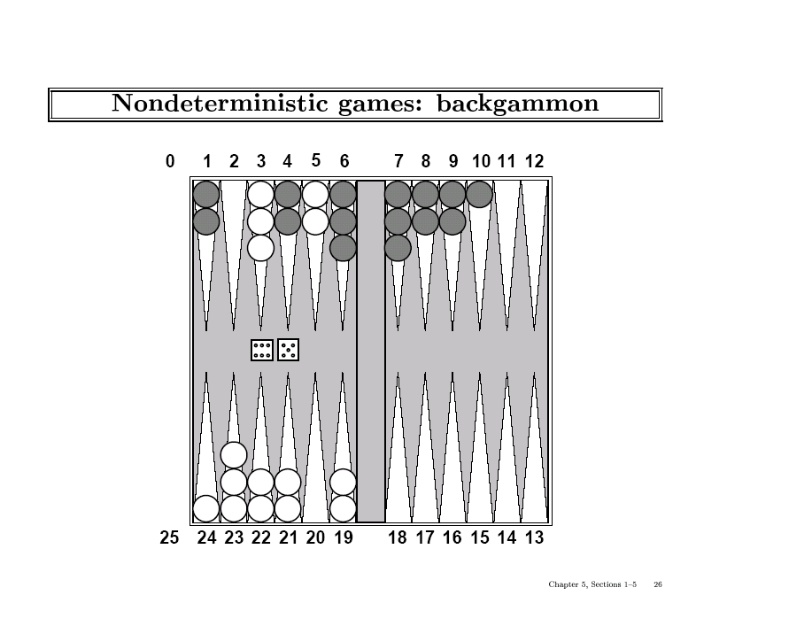

Slide 64
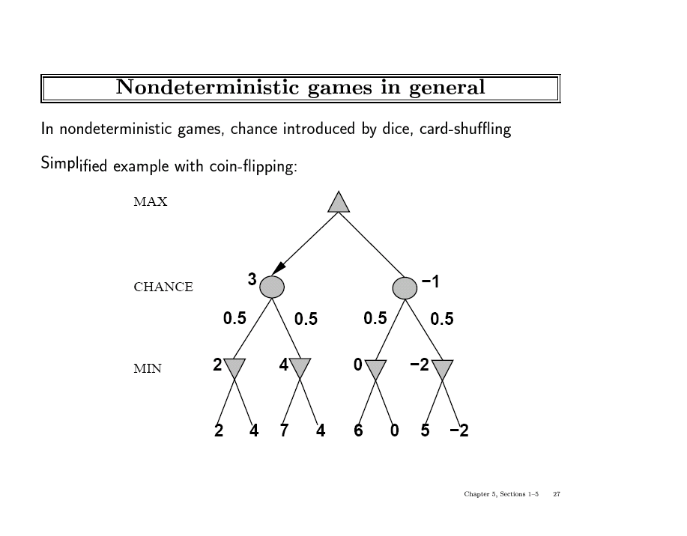

Slide 65
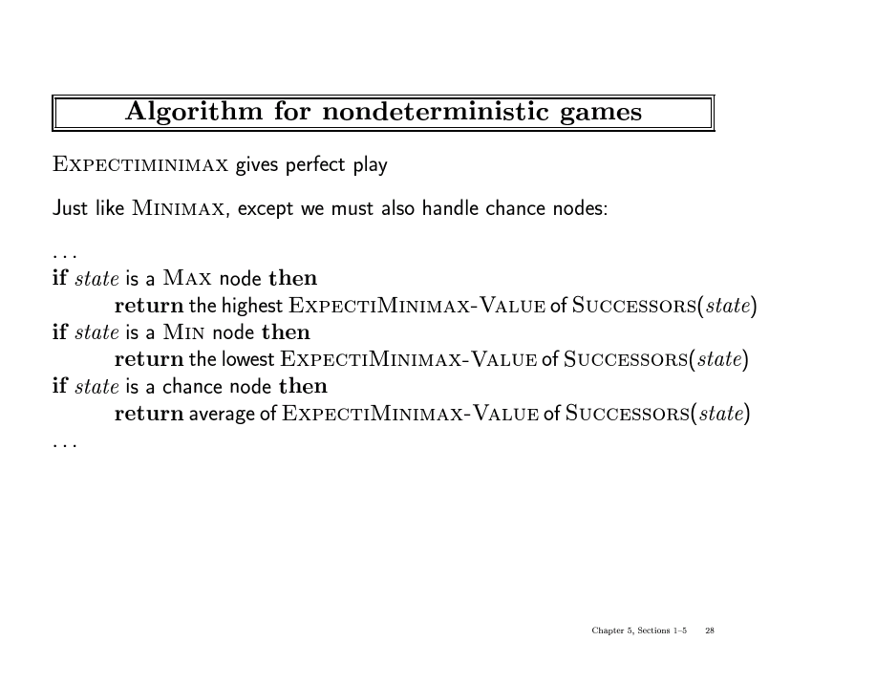

Slide 66
The State of Play
Checkers:
  Chinook ended 40-year-reign of human world champion Marion Tinsley in 1994.
Chess:
  Deep Blue defeated human world champion Garry Kasparov in a six-game match in 1997.
Othello:
  human champions refuse to compete against computers: they are too good.
Go:
  human champions refuse to compete against computers: they are too bad
  b > 300 (!)
See (e.g.) http://www.cs.ualberta.ca/~games/ for more information

Slide 67
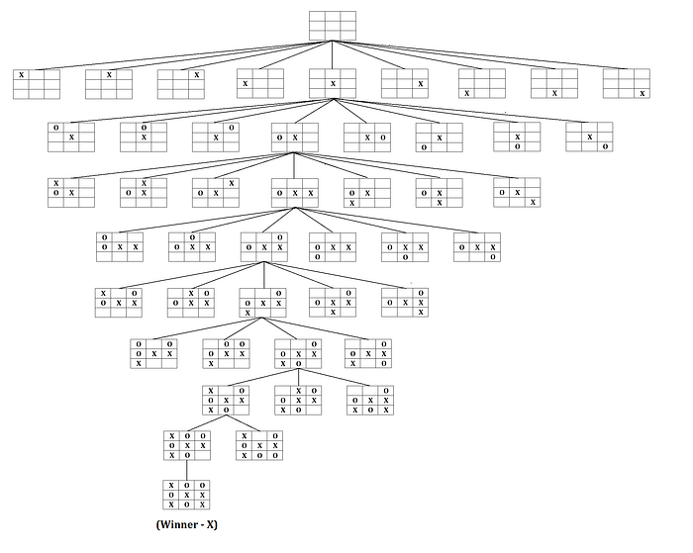
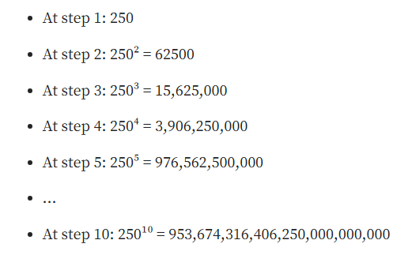
Tic-Tac Toe Problem

Slide 68
Monte Carlo Tree Search
Monte Carlo Tree Search (MCTS) is an important algorithm behind many major successes of recent AI applications such as AlphaGo’s striking showdown in 2016
Essentially, MCTS uses Monte Carlo simulation to accumulate value estimates to guide towards highly rewarding trajectories in the search tree. In other words, MCTS pays more attention to nodes that are more promising, so it avoids having to brute force all possibilities which is impractical to do.
At its core, MCTS consists of repeated iterations (ideally infinite, in practice constrained by computing time and resources) of 4 steps: selection, expansion, simulation and backup.

Slide 69
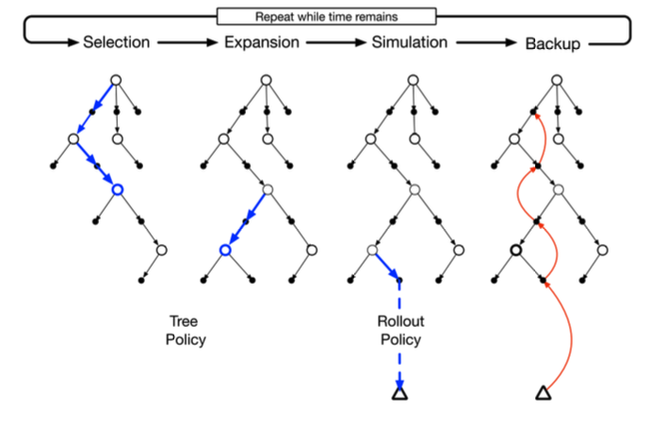
Steps in Monte Carlo Tree Search

Slide 70
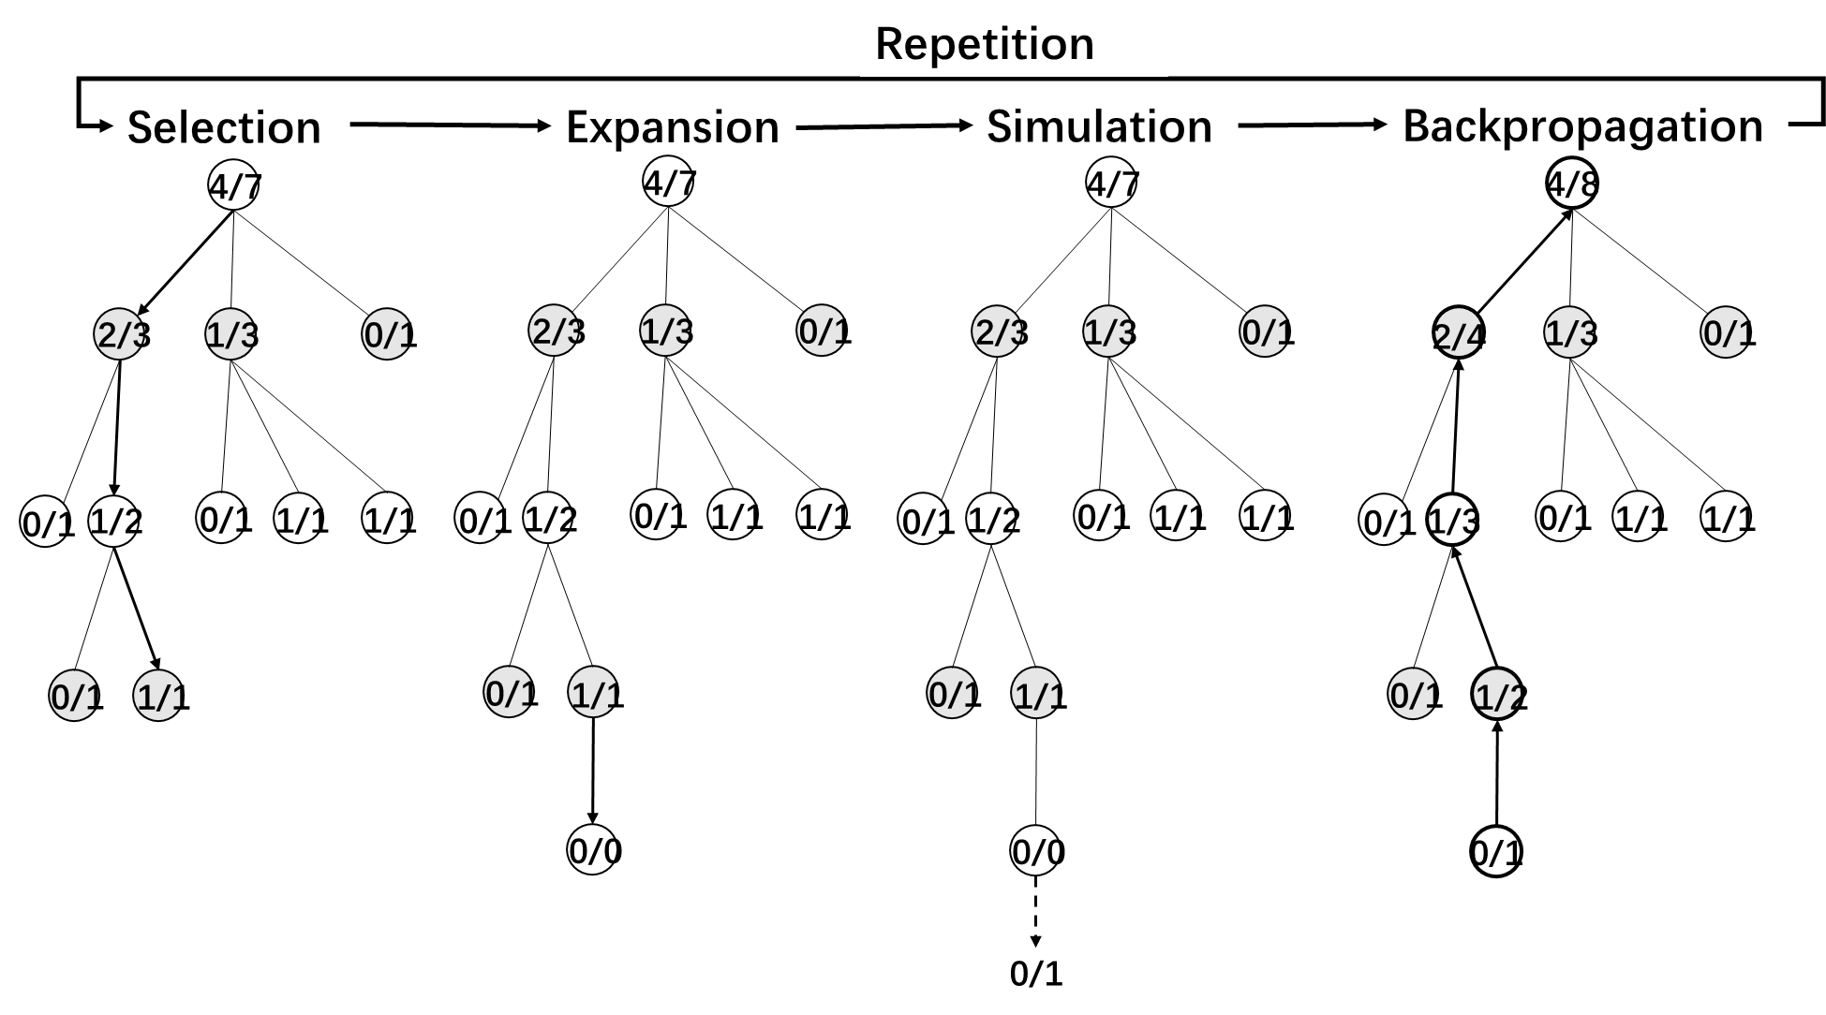
Steps in Monte Carlo Tree Search

Slide 71
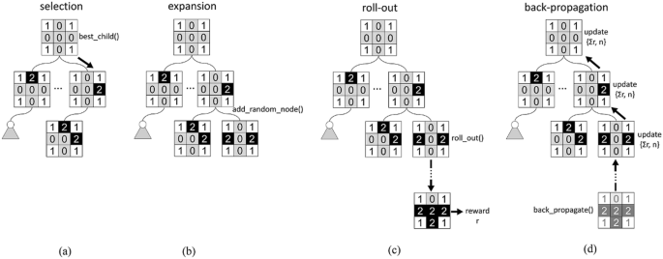
Monte Carlo Tree Search for Tic-Tac Toe Problem

Slide 72
Selection
In this step, we use tree policy to construct path from root to most promising leaf node.
A leaf node is a node which has unexplored child node(s).
A tree policy is an informed policy used for action (node) selection in the snowcap (explored part of the game tree as opposed to the vast unexplored bottom part). One important consideration of such policy is the balance of exploration vs exploitation, a recurring topic in AI, especially in Reinforcement Learning.
In the algorithm behind AlphaGo, a UCB based policy is used. More specifically, each node has an associated UCB value and during selection we always chose the child node with the highest UCB value.

Slide 73
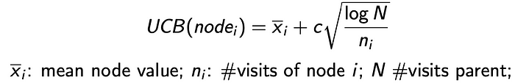
Selection
As we can see, the more a node i is visited, the lower the second term in UCB becomes, hence decreasing its probability of being selected again. Therefore, UCB algorithm has exploration and exploitation inherently built-in.

Slide 74
Expansion and Simulation
Expansion
Remember that we reach a leaf node at the end of selection?
In expansion step, we simply randomly pick an unexplored node of a leaf node.
Simulation (or Roll-out)
During this step, we roll out one or multiple simulations with reward accumulated for each simulation. Roll-out policy is normally simply or even pure random such that it is fast to execute. For example, a win might induce reward of +1, a draw for 0, and a loss for -1.

Slide 75
Backup
Backup
Now we have played out many simulations, what can we do with it to inform the best next move?
We use the accumulated rewards of simulations to back up and update the values of nodes in the snowcap.
Note: we don’t update the values of nodes during the roll-out steps!

Slide 76
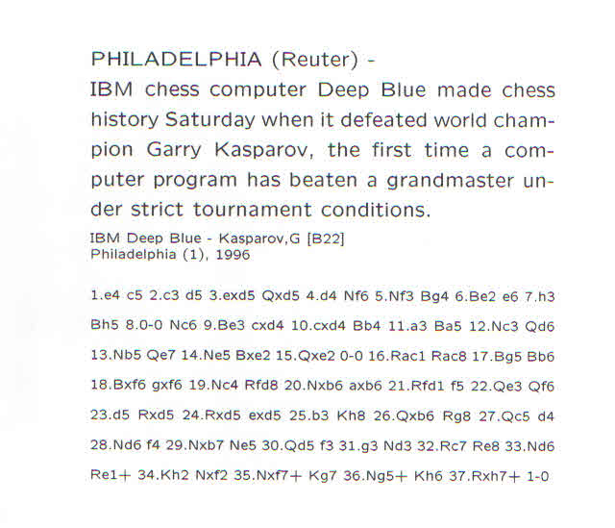

Slide 77
Deep Blue
1957: Herbert Simon
  “within 10 years a computer will beat the world chess champion”
1997: Deep Blue beats Kasparov
Parallel machine with 30 processors for “software” and 480 VLSI processors for “hardware search”
Searched 126 million nodes per second on average
  Generated up to 30 billion positions per move
  Reached depth 14 routinely
Uses iterative-deepening alpha-beta search with transpositioning
  Can explore beyond depth-limit for interesting moves

Slide 78
Summary
Game playing is best modeled as a search problem
Game trees represent alternate computer/opponent moves
Evaluation functions estimate the quality of a given board configuration for the Max player.
Minimax is a procedure which chooses moves by assuming that the opponent will always choose the move which is best for them
Alpha-Beta is a procedure which can prune large parts of the search tree and allow search to go deeper
For many well-known games, computer algorithms based on heuristic search match or out-perform human world experts.

